Slide 1
Entities, Locations, Positions
ontological view

Slide 2
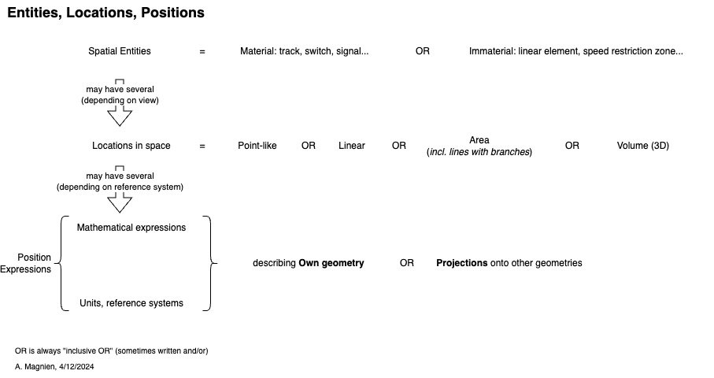
Overview

